Slide 1
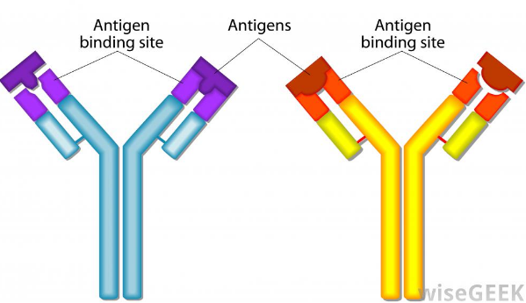
Specific Resistance to Infection
Specific Immune Response and Types of Immunity
Ch 7 Human Perspectives

Slide 2
Date: | Human Biology Year 12 ATAR
Do Now Get out your stuff, ready to start! Lesson Agenda 1: Do Now 2: Specific Immunity 3: Review Worksheet Suggested Study Complete review worksheet, mark and correct using answer key on Connect. Read through today’s notes and textbook section NEXT LESSON Past Exam Question Vaccination and Specific Immunity | Learning Aims Define specific defences against disease and list the two main cell types involved. Define “antigen” and discuss what parts of pathogens can be antigenic Describe the function of Antigen Presenting Cells (APC) in specific defence Explain where lymphocytes are produced and where they can be found. Compare B- and T- lymphocyte maturation and function List the two types of specific immunity Describe in details the function and processes involved in Antibody-Mediated (Humoral) Immunity Define “antibody” and discuss when antibodies are produced. List ways in which antibody neutralises pathogens Describe differences between the first and second time the same pathogen is encountered in terms of: Time the body takes to respond Symptoms observed Antibody concentration over time. Describe in detail the function and processes involved in Cell-Mediated Immunity Compare the processes of antibody mediated and cell mediated immunity.
 | Key Vocabulary Antigen Antibody Lymphocyte Antigen Presenting Cell

Slide 3
Specific Defences against Disease
Tailored to each individual pathogen to overcome infection AND to respond quickly on subsequent encounters to clear infection before symptoms develop.
Creates “memory” to prevent getting it again.
Eg: Once you’ve had measles, you’re immune. You don’t get it a second time (usually)
Involves Macrophages and other phagocytes
Also involved in non-specific immunity
Engulf pathogens and present antigen on surface to lymphocytes
Are therefore “Antigen Presenting Cells”.
Involves Lymphocytes
Also involved in non-specific immunity
Receive antigen and trigger specific immunity (cell-mediated and antibody mediated)
Learning Aim: Define “specific defences against disease” and list the main cell types involved

Slide 4
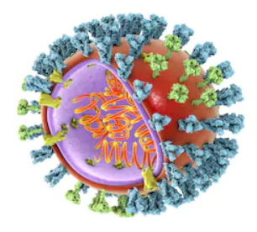
Specific Defences – What are Antigens?
Definition: A substance capable of producing an immune response:
The part of the pathogen that triggers the immune response: “antigenic site”.
May not be a pathogen: Allergy occurs when the immune system reacts to a substance that is not harmful. Vaccines contain antigen to stimulate immunity without disease.
Usually large molecules
Could be a variety of things:
Whole microorganism
Part of the protein coat
A toxin produced by a pathogen
Foreign tissue (eg donor blood or tissue)
Immune system can distinguish between self-antigens and non-self antigens
Learning Aim: Define “antigen” and discuss what parts of pathogens can be antigenic

Slide 5
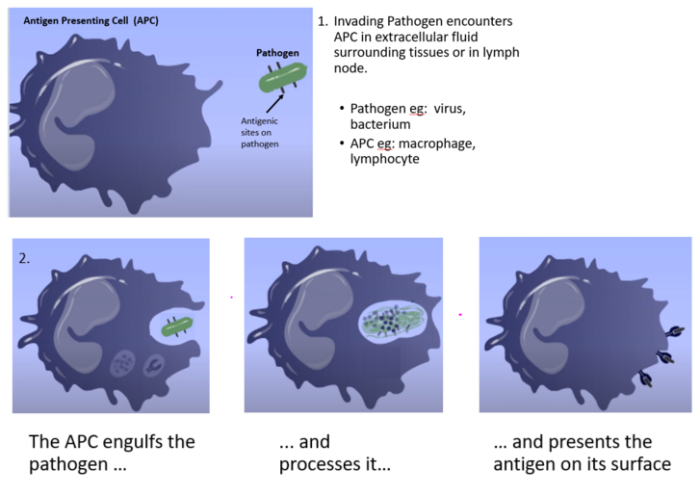
Specific Defences – Antigen Presenting Cells (APC)
These cells are phagocytes, that ingest pathogens as part of the non-specific response.
they then present the antigen (part of the pathogen that the immune system recognises) on their surface.
They “present” the antigen to lymphocytes which are involved in the specific immune response.
Some examples of APC include:
Macrophages
Some lymphocytes
(have several roles, not just APC)
Dendritic cells (not a focus in Y12 HB)
Note: many of one type of pathogen enter the
body at once, so while the APCs are doing
their work, others of the specific pathogen
are starting to cause disease.
Learning Aim: Describe the function of Antigen Presenting Cells

Slide 6
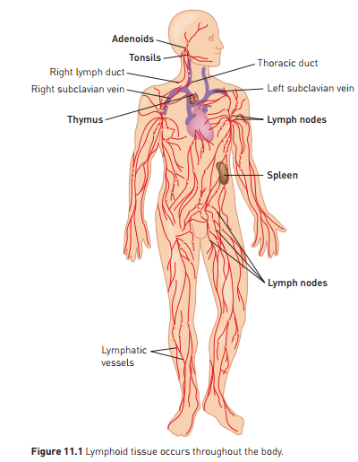
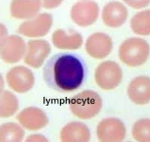
Specific Defences - Lymphocytes
Lymphocytes: white blood cells that are involved in both non-specific and specific defence
Can be found:
In blood circulation
In tissues
In lymph nodes
Produced in bone marrow.
Learning Aim: Describe where lymphocytes are produced and where they can be found

Slide 7
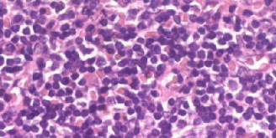
Specific Defences - Lymphocytes
2 types involved in specific immunity:
B- Lymphocytes (B-cells) – antibody mediated (humoral) immunity
T- Lymphocytes (T-cells) – cell mediated immunity
Both produced by bone marrow, but mature in different ways
B-cells:
Made in bone marrow
Mature in bone marrow
Move to lymphoid tissues and blood
Involved in anti-body mediated (humoral) immunity
T-Cells
Made in bone marrow
Mature in Thymus
Move to lymphoid tissues and blood
Involved in cell-mediated immunity
B and T cells make up the majority of the lymphoid tissues
Lymphocytes in lymphoid tissue
Learning Aim: Compare B- and T- lymphocyte maturation and function.

Slide 8
Specific Immunity
APC and lymphocytes work together to identify and neutralise specific pathogens, and form memory cells so that long-term immunity to those pathogens is achieved.
Two types of specific immunity:
Antibody-Mediated (Humoral) – deals with pathogens before entry to cells
Cell-Mediated Immunity – deals with pathogens that have entered cells
Effective for pathogens that produce consistent antigenic sites.
EG: Measles virus has consistent antigenic sites.
The first time measles is encountered, APC present the antigen to lymphocytes which act specifically to destroy the measles virus.
Memory lymphocytes are produced which remember the antigenic site for the measles virus so it can be destroyed before it causes disease the next time it is encountered.
EG: this will not work as well for the virus that causes the common cold.
the antigenic site on the cold virus varies, so cannot be recognised by memory cells in subsequent encounters

Slide 9
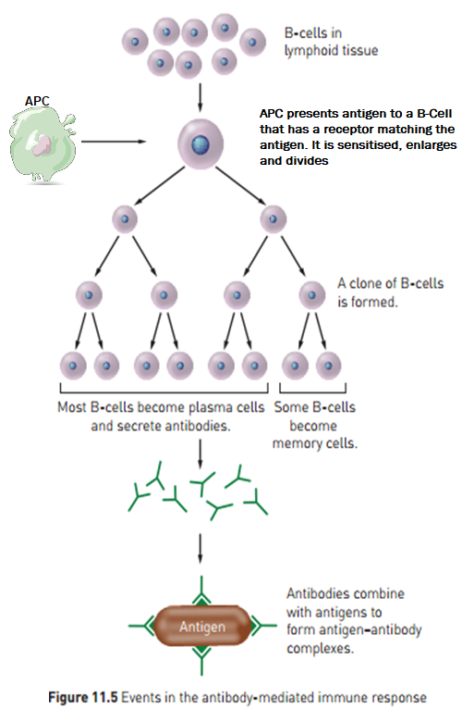
Specific Immunity: Antibody-Mediated (Humoral) Immunity
Also known as B-Cell Immunity
Involves B-lymphocytes
Made in bone marrow
Mature in bone marrow
Have thousands of unique receptors on surface
Deals with pathogens that have not yet entered body cells.
Eg viruses before entry to cell
Bacteria
Some toxins
Production and release of antibodies into blood and lymph
Learning Aim: Describe in detail the function and processes involved in antibody-mediated (humoral) immunity

Slide 10
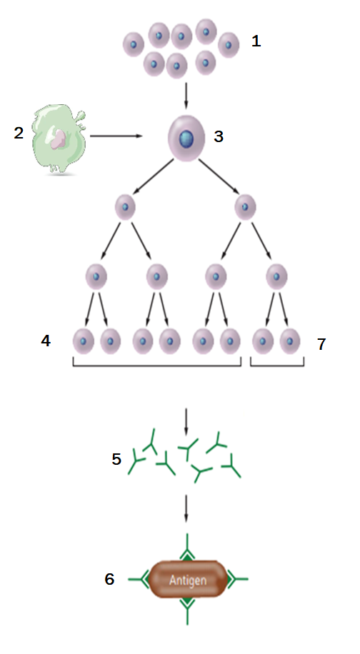
Specific Immunity: Antibody-Mediated (Humoral) Immunity
1: B-lymphocytes in lymphoid tissue
2: Antigen Presenting Cell (APC) which has engulfed and destroyed pathogen,
presents the antigenic site for that pathogen on its surface.
3: The APC presents the antigen to a B-cell with a matching receptor.
The B-cell becomes sensitised, enlarges and divides, producing
many more sensitised B-cells.
4: Most of these sensitised B-cells become plasma cells.
5: The plasma cells produce antibody specific for the antigen originally
presented by the APC.
6: The antibody is released, and is then able to bind to antigenic sites on the
same pathogens as the one originally presented by the APC, neutralising
the pathogen.
7: Sensitised Memory B-cells remain in circulation, so that the response
proceeds more quickly if the pathogen is encountered again.
Learning Aim: Describe in detail the function and processes involved in antibody-mediated (humoral) immunity

Slide 11
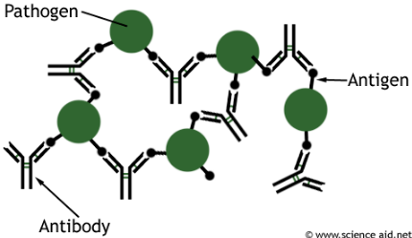
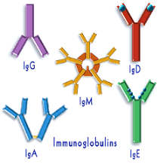
Specific Immunity: Antibodies
A special type of protein with active sites/receptors that bind to specific antigen. Forms antigen-antibody complex.
Produced during Antibody-mediated immunity in response to non-self antigens.
Antibodies are also called immunoglobulins (Ig)
Five classes – IgA, IgD, IgE, IgG, IgM
Antibodies surround pathogens and neutralise them in various ways by binding to their antigenic sites
Learning Aim: Define “antibody” and discuss when antibodies are produced

Slide 12
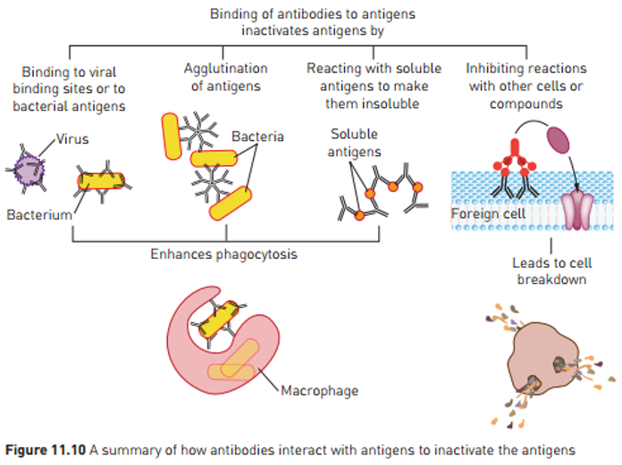
Specific Immunity: How antibodies destroy pathogens
Specific antibody is produced in response to the specific antigen for a specific pathogen after it invades.
EG: Measles antibody is produced in response to the antigenic site on the measles virus after it enters the body.
Antibody binds to the antigenic site on the pathogen, neutralising it in a variety of ways:
1: Binding to active sites so virus/bacteria/toxin
can no longer cause damage.
2: Sticking multiple pathogens together – agglutination
3: Reacting with soluble antigens to make them insoluble
4: Inhibiting reactions in foreign cells or compounds,
leading to cell breakdown
These enhance phagocytosis
Learning Aim: List and describe the ways in which antibody neutralises pathogens

Slide 13
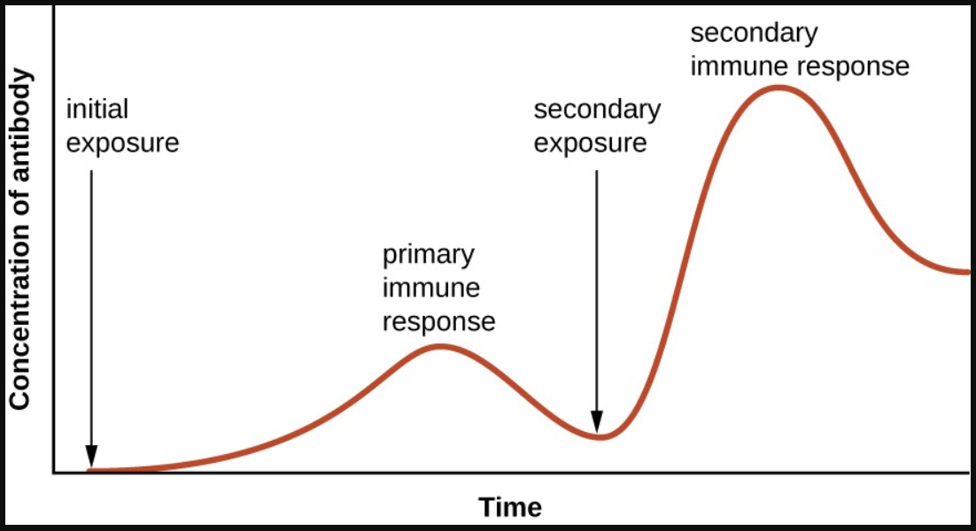
Antibody concentration over multiple exposures to a specific pathogen
Primary Response: the first time a specific antigen is encountered.
Slower response – takes several days to clone B-cells and manufacture antibody.
Symptoms occur and are then overcome.
Secondary Response: subsequent times that the specific antigen is encountered.
Faster response – memory cells allow for faster recognition of antigen and therefore antibody release, before signs of illness develop.
Learning Aim: Describe differences between the first and second time the same pathogen is encountered.

Slide 14
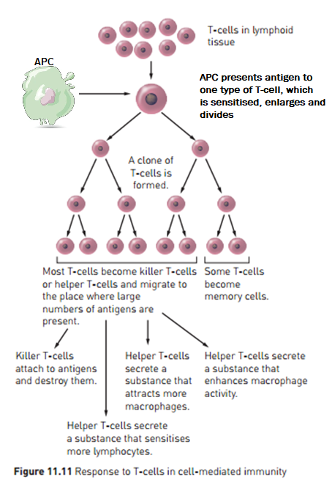
Specific Immunity: Cell-Mediated Immunity
1: T-cells (T-lymphocytes) in lymphoid tissue.
2: APC has engulfed pathogen and
presents antigen to one type
of T-cell.
3: T-cell is sensitised, enlarges and
divides.
4: Many clones of the T-cell are produced,
sensitised for the antigen that was
presented.
5: Sensitised T-cells can be:
Killer T-Cells (Cytotoxic T-Cells)
Cells that have been infected have markers on their surface.
Killer T-Cells move to sites of infection
Attach to infected or foreign cells and destroy them.
Suppressor T-Cells
Stop action of Killer T-Cells once infected cells have been destroyed.
Helper T-Cells
Secrete substances that sensitise more lymphocytes, attract macrophages and enhance macrophage activity
Memory T-Cells
Remain sensitised to the specific pathogen, in circulation and tissues, so that future responses to the pathogen are much more rapid.
Also known as T-Cell Immunity
Involves T-Lymphocytes
Made in bone marrow
Mature in Thymus
Deals with pathogens that have entered cells eg:
Viruses which replicate inside cells
Some bacteria that replicate inside cells (eg Tuberculosis)
Deals with “abnormal” or “foreign” cells:
Fungi
Parasites
Tissue transplant rejection
Fighting cancer cells.
Learning Aim: Describe in detail the function and processes involved in cell-mediated immunity

Slide 15
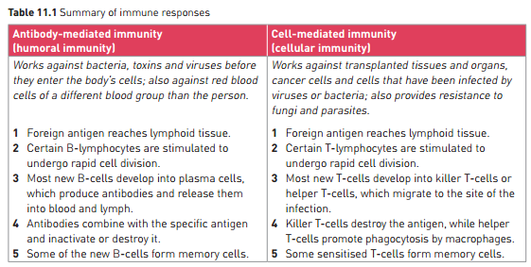
Learning Aim: Compare the processes of antibody-mediated and cell-mediated immunity

Slide 16
